Slide 1
FRUIT COUNTING USING YOLOv5
.

Slide 2
TABLE OF CONTENTS
1
2
3
4
5
6
INTRODUCTION
OBJECTIVES
LITERATURE REVIEW
METHODOLOGY
RESULTS
CONCLUSION

Slide 3
INTRODUCTION
We have proposed a system to count the on-tree fruits in an orchard with the intention to help in the process of yield estimation of the farmers. The fruit under consideration for this project is Apple.

Slide 4
OBJECTIVES
Making an apple detection and counting system optimized to work on orchards

Slide 5
OBJECTIVES
To overcome the following challenges while detection
ILLUMINATION
DISTANCE
ON-GROUND
To work on images from fields with varied illumination conditions
To perform detection of apples from a distance that is usually kept from trees while traversing the orchard
To provide the count taking into consideration the on-ground fruits too

Slide 6
LITERATURE REVIEW
MANYA AFONSO et al.
Worked on tomatoes using Mask RCNN with R50, R101 and X101 architectures trained on custom dataset. Precision = 81.57%
J.P. VASCONEZ et al.
Deployed Faster RCNN and Mobilenet to detect Avocado, Lemon and Apple with precision 72% and 53% respectively.
NICOLAI HANI et al.
Used CNN for detection and counting of apples along with yield estimation with an average precision 88.48%

Slide 7
METHODOLOGY
ANNOTATION
TRAINING
Annotation of images marking the boundaries of apples with coordinates
Training YOLOv5 on our images along with their annotations
TESTING
COMPARISON
Testing the trained model on unseen images from our orchard dataset to evaluate its performance
Comparing the performances of YOLOv5s, YOLOv5x and YOLOv5n

Slide 8
RESULTS
Model | Precision | Recall | mAP@.5
YOLOv5s | 0.648 | 0.595 | 0.626
YOLOv5x | 0.624 | 0.564 | 0.597
YOLOv5n | 0.588 | 0.617 | 0.588

Slide 9
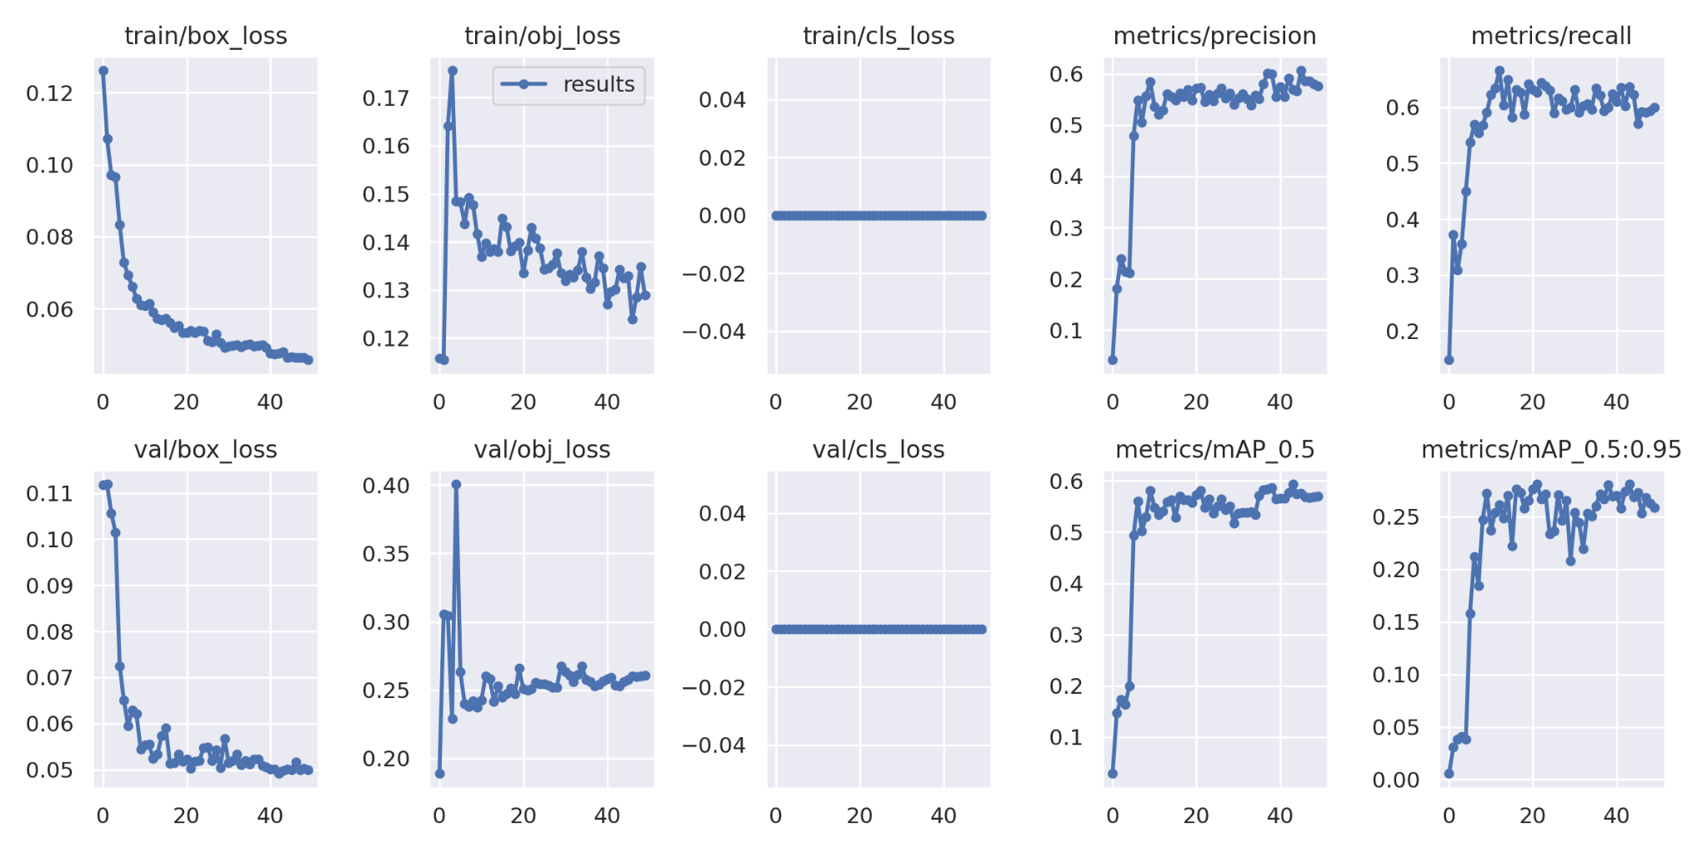
RESULTS ANALYSIS

Slide 10
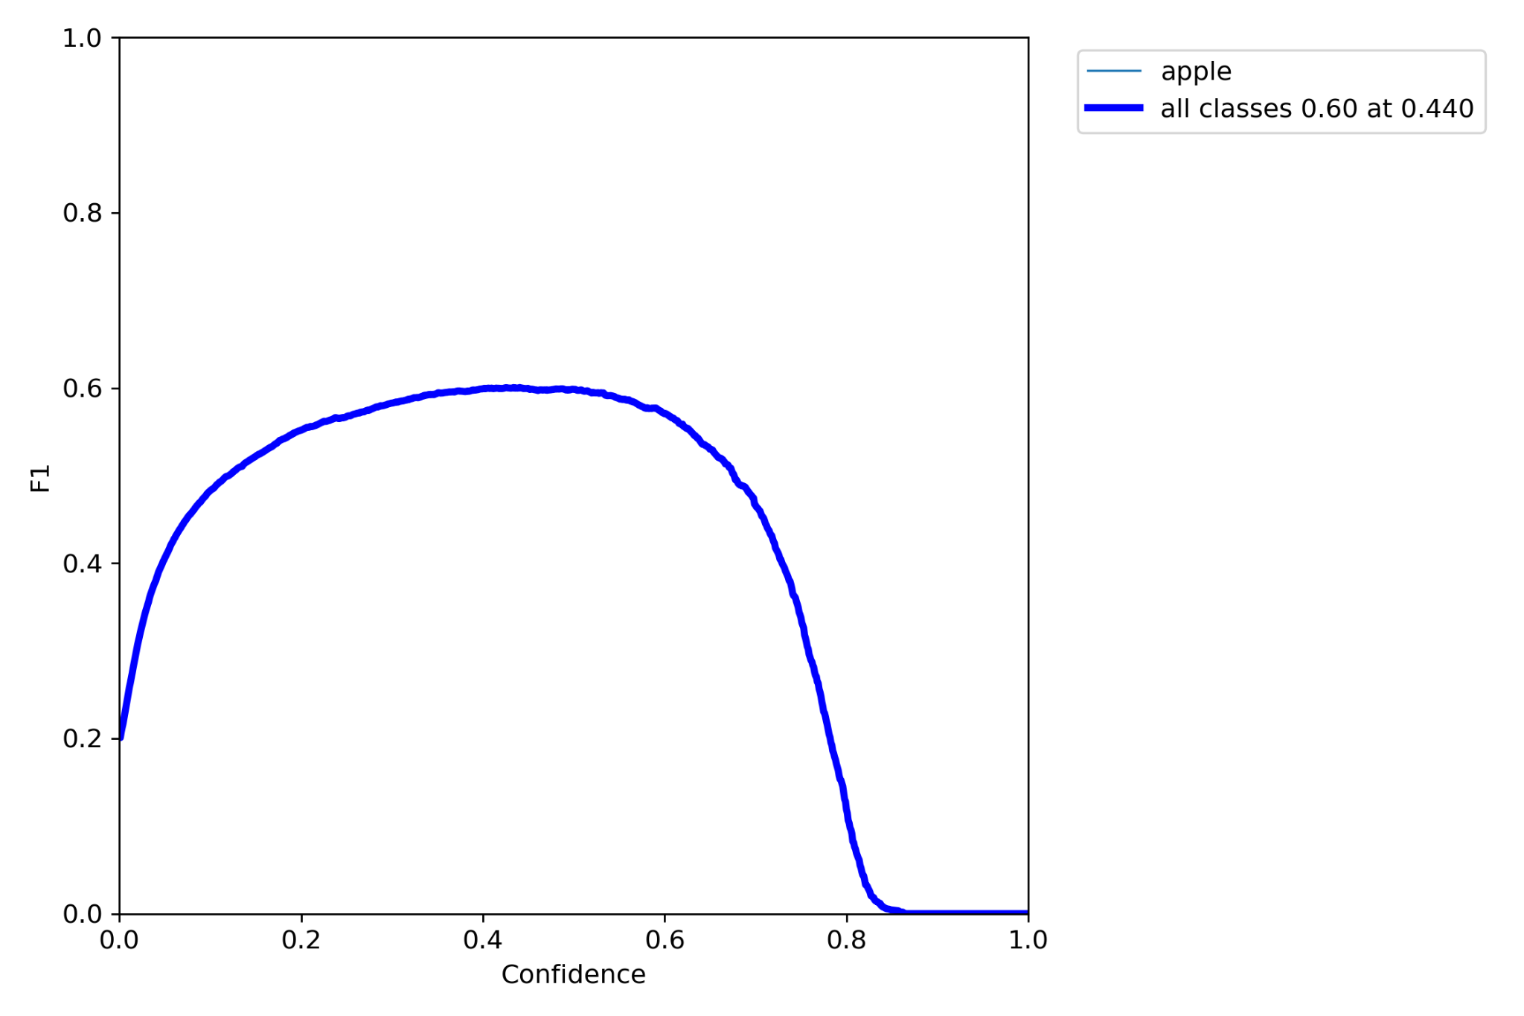
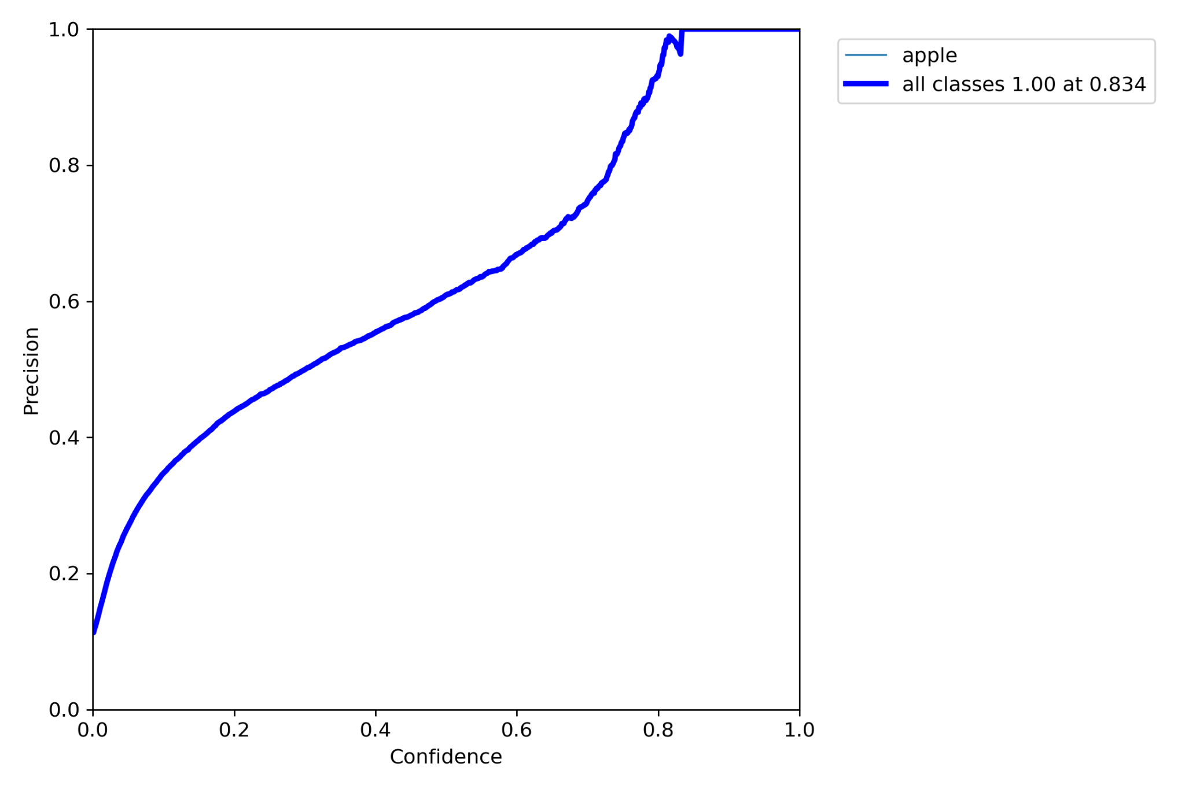
F1 CURVE
P CURVE

Slide 11
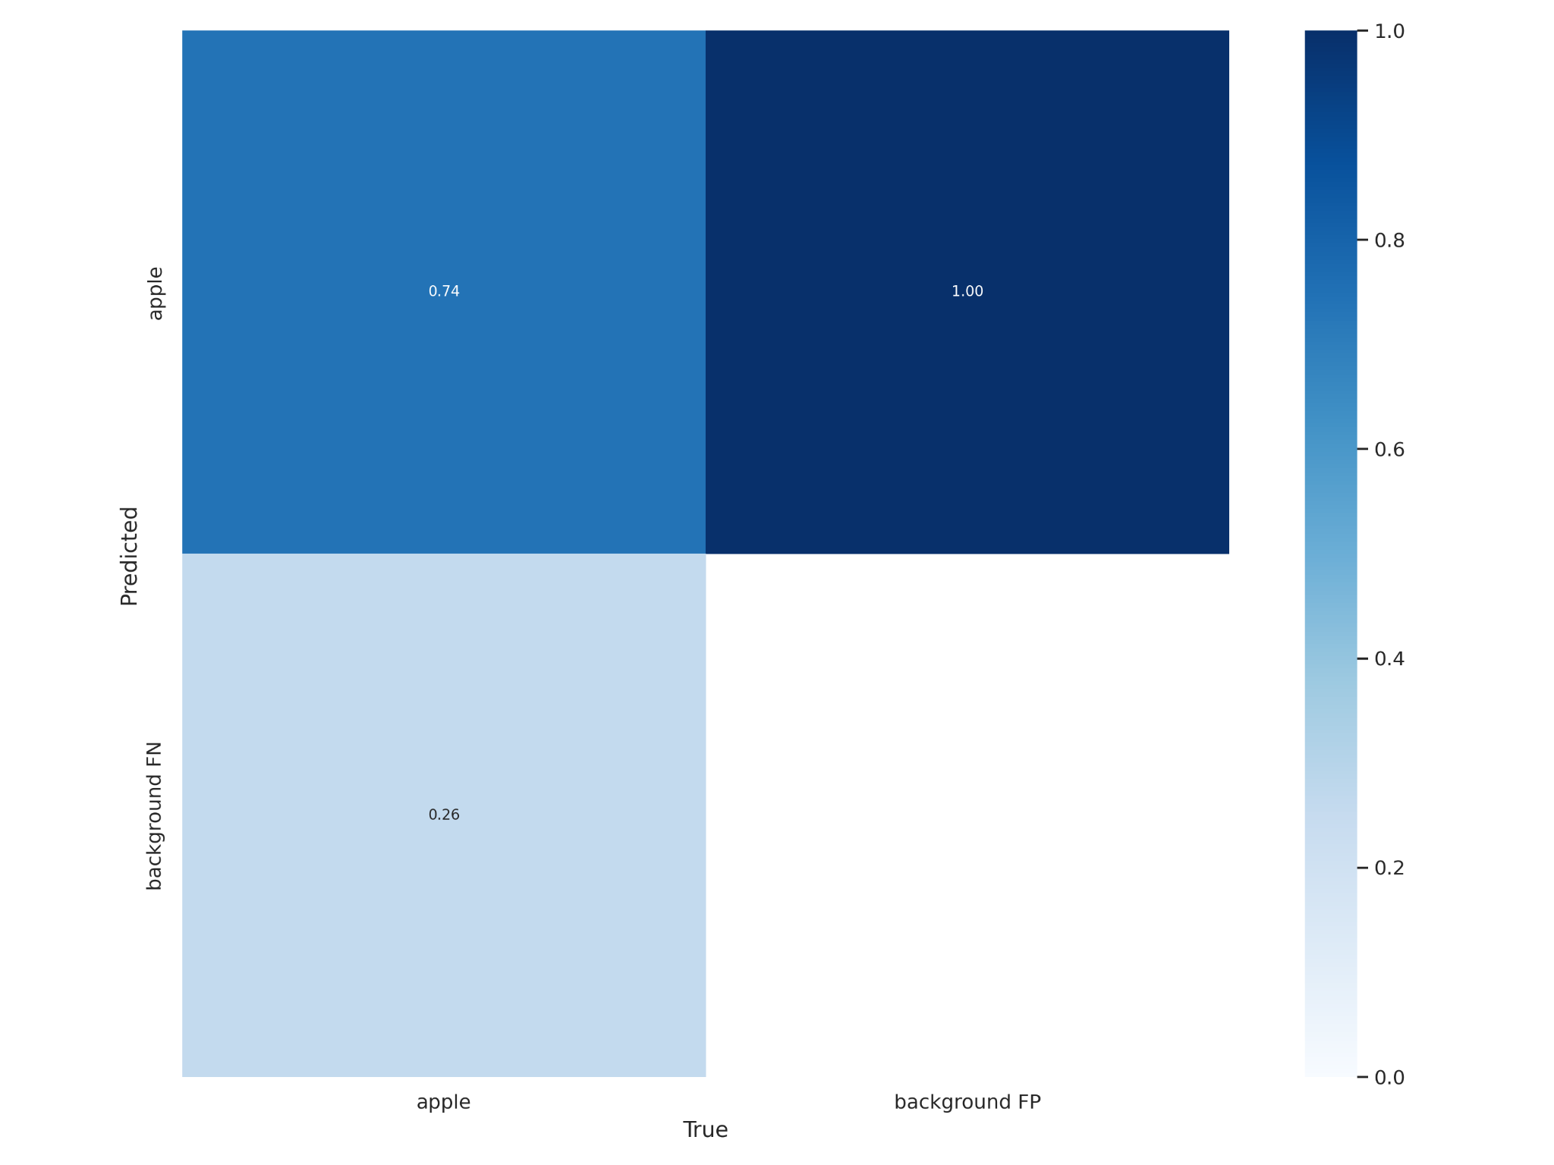
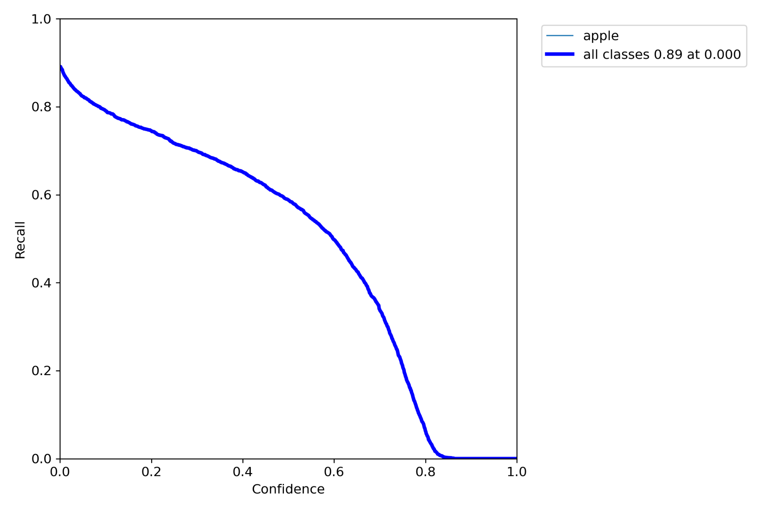
R CURVE
CONFUSION MATRIX

Slide 12
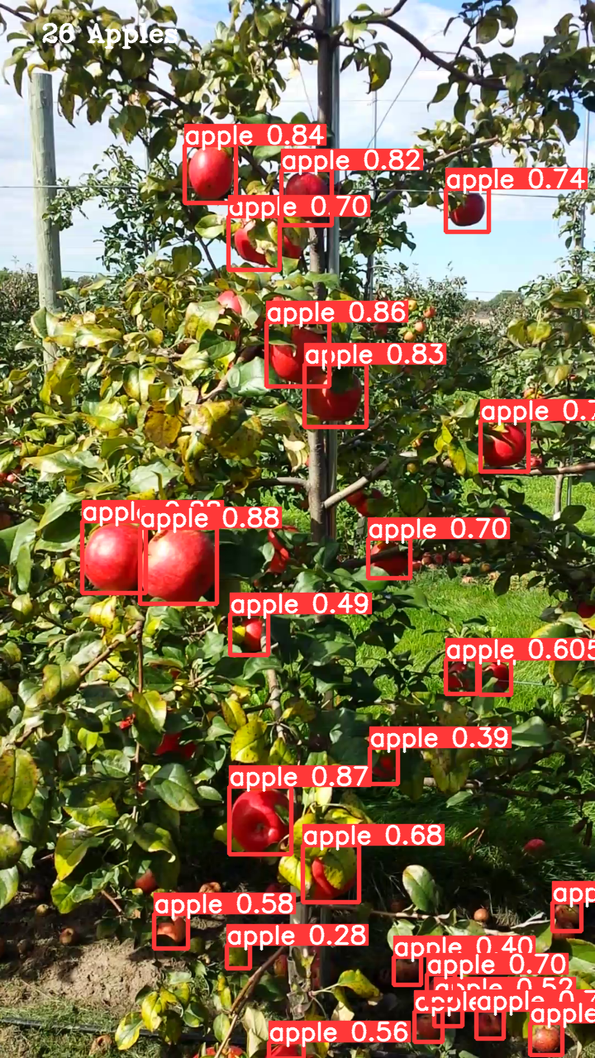
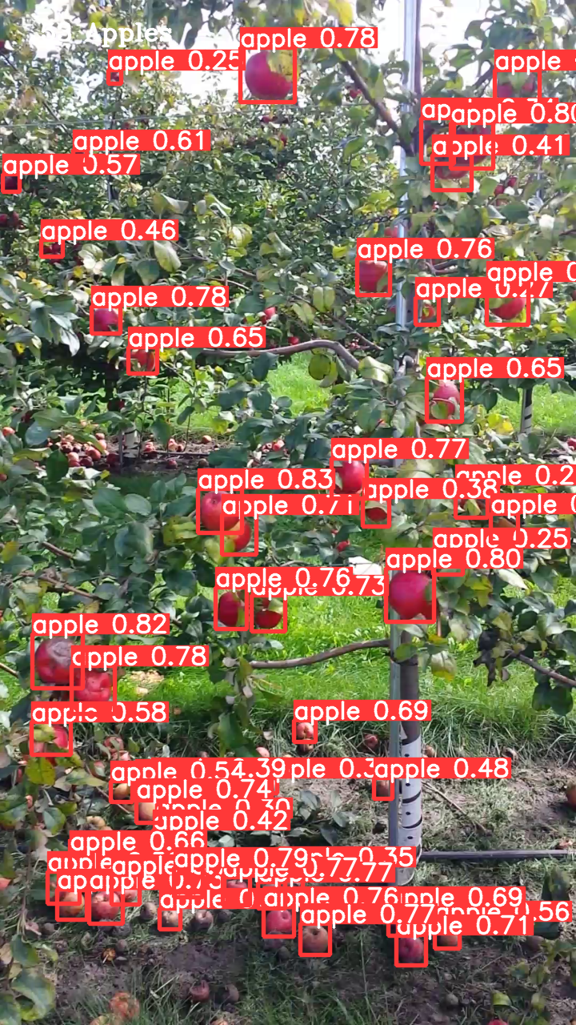
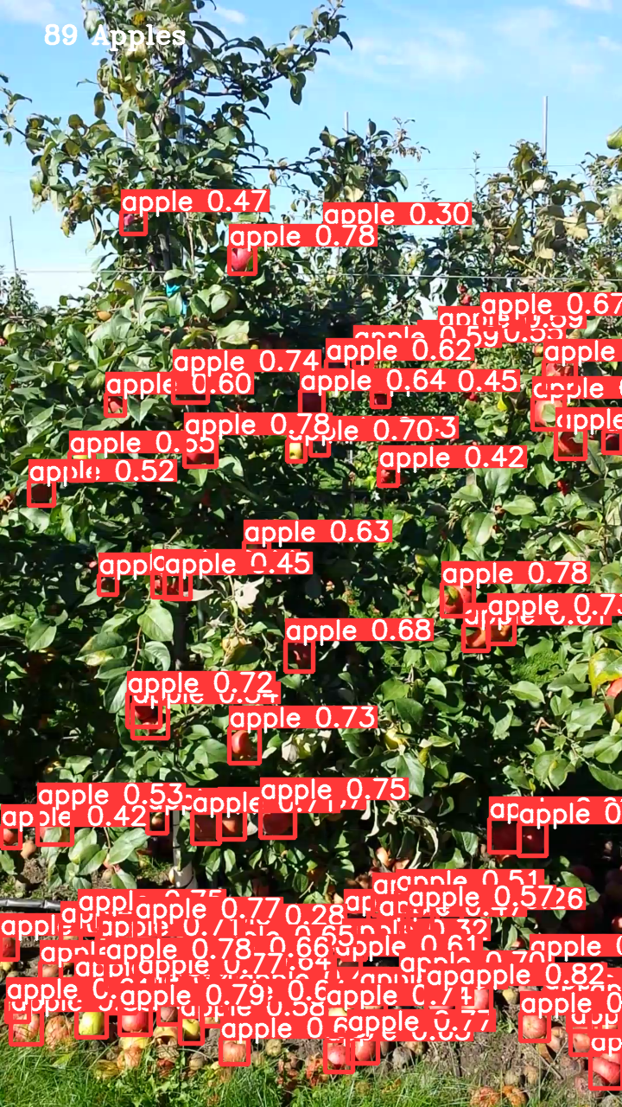

Slide 13
CONCLUSION & FUTURE WORK
ACHIEVEMENT OF OBJECTIVES
We have trained YOLOv5 to detect apples and count them on images taken from apple orchards overcoming the challenges mentioned before
BEST MODEL
While comparing three versions of YOLOv5, we found YOLOv5s to be delivering best results to us
NEXT BIT
To integrate our solution with a mobile application so that farmers can estimate their yield using their phone’s camera

Slide 14
REFERENCES
[1] L. Fu et al., "Banana detection based on color and texture features in the natural environment", Computers and Electronics in Agriculture, vol. 167, p. 105057, 2019. Available: 10.1016/j.compag.2019.105057.
[2] M. Afonso et al., "Tomato Fruit Detection and Counting in Greenhouses Using Deep Learning", Frontiers in Plant Science, vol. 11, 2020. Available: 10.3389/fpls.2020.571299.
[3] J. Vasconez, J. Delpiano, S. Vougioukas and F. Auat Cheein, "Comparison of convolutional neural networks in fruit detection and counting: A comprehensive evaluation", Computers and Electronics in Agriculture, vol. 173, p. 105348, 2020. Available: 10.1016/j.compag.2020.105348.
[4] N. Häni, P. Roy and V. Isler, "Apple Counting using Convolutional Neural Networks," 2018 IEEE/RSJ International Conference on Intelligent Robots and Systems (IROS), 2018, pp. 2559-2565, doi: 10.1109/IROS.2018.8594304.
[5] F. Gao et al., "Multi-class fruit-on-plant detection for apple in SNAP system using Faster R-CNN", Computers and Electronics in Agriculture, vol. 176, p. 105634, 2020. Available: 10.1016/j.compag.2020.105634.
[6] S. Sun, M. Jiang, D. He, Y. Long and H. Song, "Recognition of green apples in an orchard environment by combining the GrabCut model and Ncut algorithm", Biosystems Engineering, vol. 187, pp. 201-213, 2019. Available: 10.1016/j.biosystemseng.2019.09.006
[7] A. Parico and T. Ahamed, "Real Time Pear Fruit Detection and Counting Using YOLOv4 Models and Deep SORT", Sensors, vol. 21, no. 14, p. 4803, 2021. Available: 10.3390/s21144803.
[8] M. Rahnemoonfar and C. Sheppard, "Deep Count: Fruit Counting Based on Deep Simulated Learning", Sensors, vol. 17, no. 4, p. 905, 2017. Available: 10.3390/s17040905.
[9] X. Liu, D. Zhao, W. Jia, W. Ji and Y. Sun, "A Detection Method for Apple Fruits Based on Color and Shape Features", IEEE Access, vol. 7, pp. 67923-67933, 2019. Available: 10.1109/access.2019.2918313.
[10] J. Feng, L. Zeng and L. He, "Apple Fruit Recognition Algorithm Based on Multi-Spectral Dynamic Image Analysis", Sensors, vol. 19, no. 4, p. 949, 2019. Available: 10.3390/s19040949.
[11] K. Simonyan and A. Zisserman, "Very Deep Convolutional Networks for Large-Scale Image Recognition", Export.arxiv.org, 2021. [Online]. Available: https://export.arxiv.org/abs/1409.1556. [Accessed: 18- Sep- 2021].
[12] J. Redmon, "YOLO: Real-Time Object Detection", Pjreddie.com, 2021. [Online]. Available: http://pjreddie.com/yolo/. [Accessed: 18- Sep- 2021].

Slide 15
THANKS!

